Slide 1
AJAX Introduction
Asynchronous JavaScript And XML
Based on slides from Tom Hunter and Sang Shin. See the originals here:
http://curmudgeon99.googlepages.com
http://www.javapassion.com/ajax/AJAXBasics.pdf

Slide 2
Rich User Experience
Take a look at a typical desktop application (Spread sheet app, etc.)
The program responses intuitively and quickly
The program gives a user meaningful feedback's instantly
A cell in a spread sheet changes color when you hover your mouse over it
Icons light up as mouse hovers them
Things happen naturally
No need to click a button or a link to trigger an event

Slide 3
Characteristics of Conventional Web Applications
“Click, wait, and refresh” user interaction
Page refreshes from the server needed for all events, data submissions, and navigation
Synchronous “request/response” communication model
The user has to wait for the response
Page-driven: Workflow is based on pages
Page-navigation logic is determined by the server

Slide 4
Issues of Conventional Web Application
Interruption of user operation
Users cannot perform any operation while waiting for a response
Loss of operational context during refresh
Loss of information on the screen
Loss of scrolled position
No instant feedback's to user activities
A user has to wait for the next page
Constrained by HTML
Lack of useful widgets
These are the reasons why Rich Internet Application (RIA) technologies were born.

Slide 5
Rich Internet Application (RIA) Technologies
Applet
Adobe Flash
Java WebStart
MS Silverlight
HTML, CSS and JavaScript (AJAX)

Slide 6
Applet
Pros
Cons
Can use full Java APIs
Custom data streaming, graphic manipulation, threading, and advanced GUIs
Well-established scheme
Code downloading time could be significant
Use it if you are creating advanced UIs on the client and download time is not a major concern

Slide 7
Adobe Flash
Designed for playing interactive movies
Programmed with ActionScript
Implementation examples
Adobe Flex
Laszlo suite (open source)
Pros:
Good for displaying vector graphics
Cons:
Browser needs a Flash plug-in
ActionScript is proprietary
Not supported on all devices

Slide 8
Java WebStart
Desktop application delivered over the net
Leverages the strengths of desktop apps and applet
Pros
Desktop experience once loaded
Leverages Java technology to its fullest extent
Disconnected operation is possible
Application can be digitally signed
Incremental redeployment
Cons
Old JRE-based system do not work
First-time download time could be still significant

Slide 9
HTML, CSS and JavaScript
DHTML plus Asynchronous communication capability through XMLHttpRequest
Pros
Most viable RIA technology so far
Tremendous industry momentum
Several toolkits and frameworks are emerging
No need to download code & no plug-in required
Cons
Still browser incompatibility
JavaScript is hard to maintain and debug
AJAX tools and api's helps

Slide 10
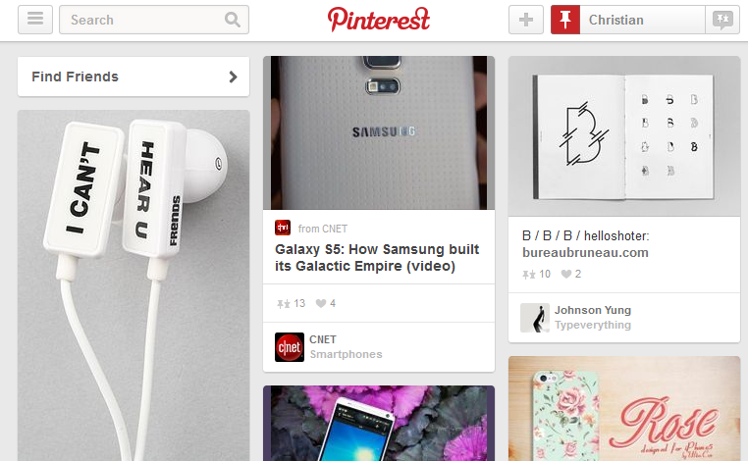
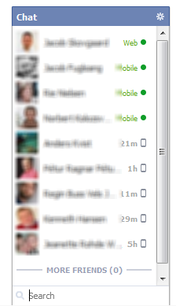
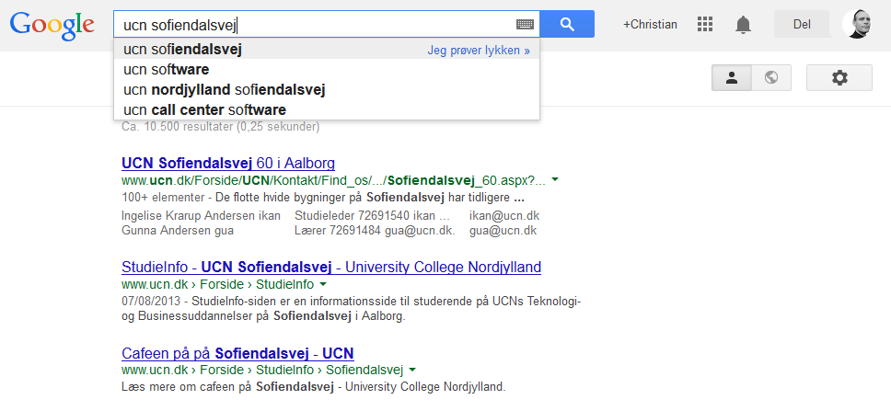
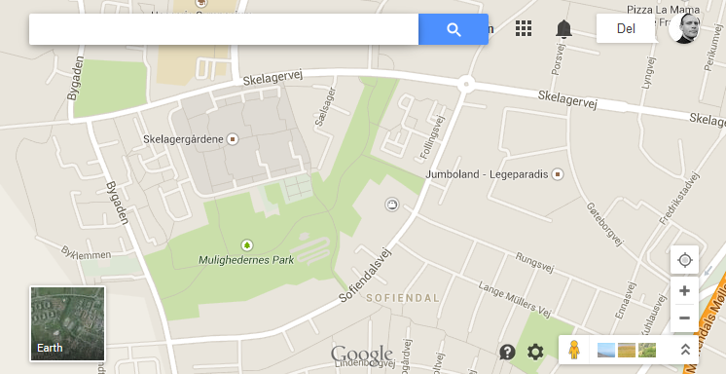
Real-Life Examples of AJAX Apps

Slide 11
Usage cases for AJAX
Real-time server-side input form data validation
User IDs, serial numbers, postal codes
Removes the need to have validation logic at both client side for user responsiveness and at server side for security and other reasons
Auto-completion
Email address, name, or city name may be auto-completed as the user types
Master detail operation
Based on a user selection, more detailed information can be fetched and displayed

Slide 12
Usage cases for AJAX
Advanced GUI widgets and controls
Controls such as tree controls, menus, and progress bars may be provided that do not require page refreshes
Refreshing data
HTML pages may poll data from a server for up-to-date data such as scores, stock quotes, weather, or application-specific data
Simulating server side notification
An HTML page may simulate a server-side notification by polling the server in the background.

Slide 13
Why AJAX?
Intuitive and natural user interaction
No clicking required
Mouse movement is a sufficient event trigger
"Partial screen update" replaces the "click, wait, and refresh" user interaction model
Only user interface elements that contain new information are updated (fast response)
The rest of the user interface remains displayed without interruption (no loss of operational context)
Data-driven (as opposed to page-driven)
UI is handled in the client while the server provides data

Slide 14
Why AJAX?
Asynchronous communication replaces "synchronous request/response model."
A user can continue to use the application while the client program requests information from the server in the background
Separation of displaying from data fetching

Slide 15
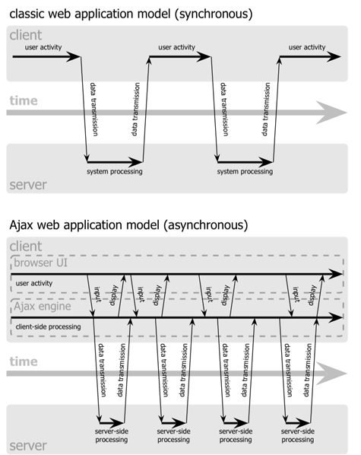
Interrupted
user operation while the data is being fetched
Uninterrupted
user operation while data is being fetched

Slide 16
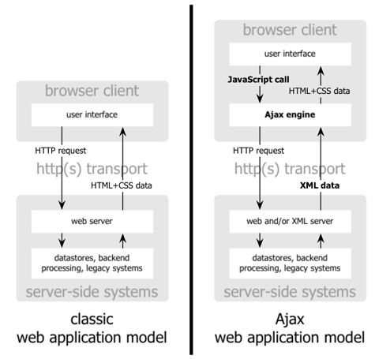

Slide 17
AJAX: A Quick Overview
A special Request object is created.
A JavaScript Function is Called.
An Asynchronous Request is sent.
The response eventually comes.
The HTML of the page is changed.

